Slide 1
Evaluation of verducatib NDA Submission/Approval Timeline

Slide 2
The Under-Assessment Acceleration in the NDA Submission/Approval Timeline
Aiming for NRDL Negotiation in 2028 (same cycle with HSK31858 which is estimated to be approved Q1 2028 or earlier in Q4 2027
Pre-requisite for 2028 NRDL Negotiation
Oct 29, 2027
DBL(1)
Jul 26, 2027
TLR
05 Aug 2027
BTD feedback/Pre-NDA (PR) Feedback
Oct 2027
Accelerated:
NDA Submission
Oct 2027
Best case:
NDA Submission
Dec 2027
Accelerated:
NDA Approval
June 2028
Best case NDA Approval
Dec 2028
Base case NDA Approval
June 2029
BTD*/China pre-NDA (PR) sub.
Aug 2027
China submission
US submission
EU submission
Abbreviation:
NDA: New Drug Application
NRDL: National Reimbursement Drug List
DBL: Database lock
TLR:Top-Line Results
BTD:Breakthrough Therapy Designation
PR: Priority Review
PoS: Probability of Success
CDE:Center for Drug Evaluation
NDA submission in Oct 2027 is a shared goal for US/EU, and China.
The evaluation was well aligned with global clinical development team (evidence team).
* BTD is just to try with low PoS given CDE did not supported in End of PhII interaction.
Notes:
*Process Performance Qualification

Slide 3
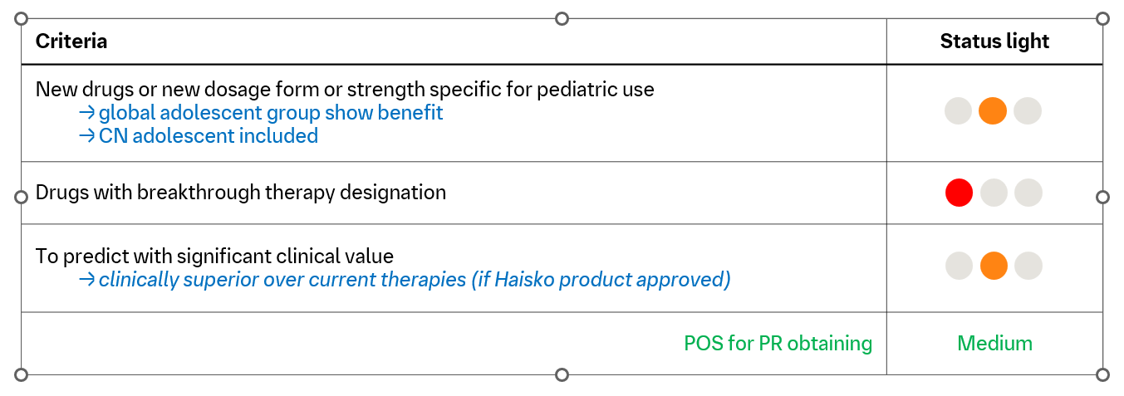
NDA approval by June 2028 is team shared goal, while the possibility is low
China original NDA submission timeline is in Dec 2027. Submission by Oct 2027 (2 months acceleration) is possible mainly driven by global submission dossier ready, which leads to the best approval in Oct 2028 if priority review (PR) is granted (Boehringer benchmark in HPBU time tracker is 12 month).
Health Authority review timeline is significantly shorter than Boehringer benchmark in HPBU time tracker(8 vs 12 months) if the target is to approve by Jun 2028 with PR granted.
Possibility of PR is medium as assessed.
Notes:
Decision Tree​ (draft)
Effect size >20% in PE + positive secondary endpoints → Proceed with full-speed submission​
Lower effect size / negative trends → Further evaluation + business case review​

Slide 4
Driving Acceleration Through Proactive Action
Next Step
Push adolescent population enrollment.
Close collaborate with global team regarding NDA strategy (expedited pathway/labeling/adolescent evidence) development and revisit at critical milestones.
Initiate NDA submission preparation on 1st June 2026 based on accelerated timeline and pre-assessment.

